Slide 1
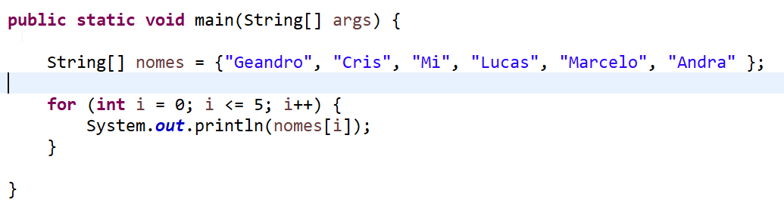
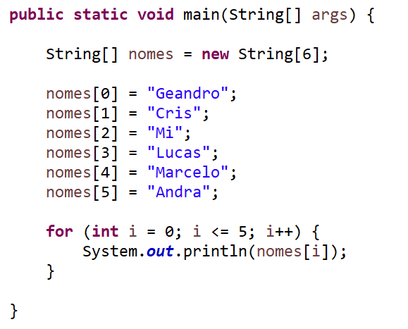
[0] Geandro
[1] Cris
[2] Mi
[3] Lucas
[4] Marcelo
[5] Andrea

Slide 2
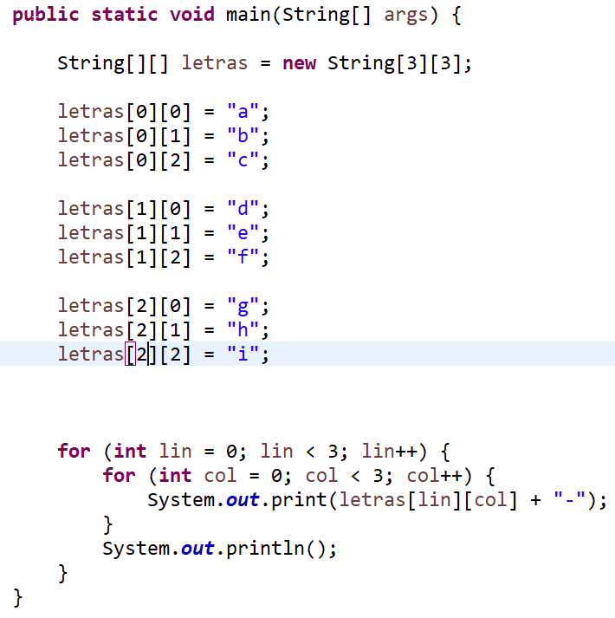
[0][0] “a” | [0][1] “b” | [0][2] “c”
[1][0] “d” | [1][1] “e” | [1][2] “f”
[2][0] “g” | [2][1] “h” | [2][2] “i”

